Slide 1
ACID vs. BASE Properties Comparison Using Ecommerce DATASET
BY – DEVARSH PATEL
HARSH RANPURA
KATHAN PATHAK
VRAJ PATEL
DIVY PATEL
DEVANSHI PATEL

Slide 2
01
Introduction

Slide 3
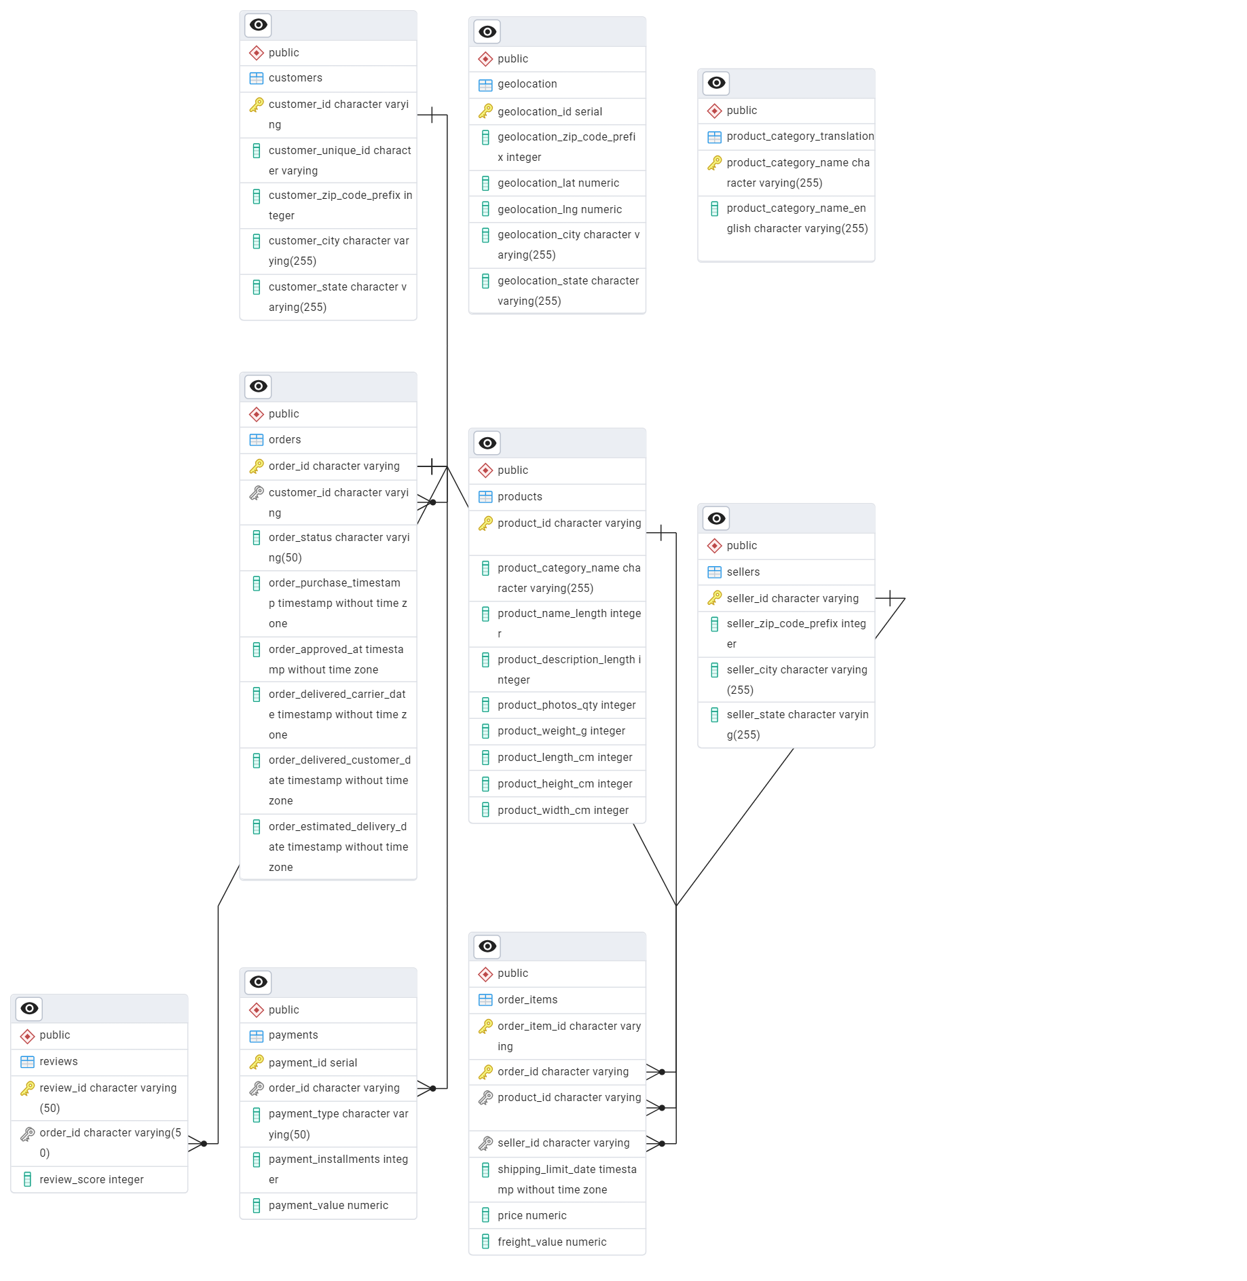
Entity Relationship Diagram

Slide 4
Introduction - ACID vs. BASE Properties Testing Using E-commerce Platform Analysis
DBMS
Objective: Compare two database models—PostgreSQL (ACID) and MongoDB (BASE)—within the context of an e-commerce platform.
Dataset: Brazilian E-commerce (Olist) dataset, including orders, payments, reviews, and delivery data.
Focus Areas: Evaluate performance, scalability, consistency, flexibility, and speed in handling typical e-commerce operations like processing orders and managing customer reviews.
Goal: Provide actionable insights on the strengths and weaknesses of relational (SQL) and NoSQL databases to help businesses make informed data management decisions.

Slide 5
ACID
DBMS
The ACID properties in databases are a set of principles that ensure reliable processing of database transactions. Each letter represents a key property that a transaction should maintain:
A - Atomicity:
Ensures that a transaction is an indivisible unit of work.
Either all operations in the transaction are completed successfully, or none are applied. If any part of the transaction fails, the database is rolled back to its previous state.
C - Consistency:
Ensures that a transaction brings the database from one valid state to another.
Any transaction must comply with all defined rules, constraints, and relationships in the database, preserving the database's integrity.
I - Isolation:
Ensures that transactions are executed independently of one another.
. The intermediate states of a transaction are not visible to other transactions until the transaction is completed, avoiding interference and ensuring correctness.
D - Durability:
Ensures that once a transaction is committed, its effects are permanently stored in the database, even in the event of system crashes or failures.

Slide 6
BASE
DBMS
The BASE properties describe a model often used by NoSQL databases to provide high availability and scalability in distributed systems. Unlike ACID, BASE sacrifices strict consistency in favor of eventual consistency and operational flexibility. It stands for :
BA - Basically Available:
Ensures the system is always available to respond to requests, even if some of the nodes are down.
Prioritizes system uptime over immediate consistency, making it ideal for distributed systems.
S - Soft State:
The state of the system might change over time, even without new input, due to eventual consistency.
Data is propagated across nodes asynchronously, leading to temporary inconsistencies.
E - Eventually Consistency:
Guarantees that all nodes in the system will eventually reflect the same data, ensuring consistency in the long term.
Best suited for applications where real-time consistency is not critical, such as social media or content delivery.

Slide 7
When to Use MongoDB and PostgreSQL
DBMS
MongoDB: Best for non-relational, schema-less data with fewer cross-references (e.g., customer reviews, logs, real-time analytics).
PostgreSQL: Best for structured, highly relational data requiring frequent JOINs or aggregations (e.g., orders, customers, payments).

Slide 8
When to Use MongoDB and PostgreSQL
DBMS
When to Use ACID (PostgreSQL):
Applications that require strong consistency and data integrity, such as:
Financial systems (e.g., banking, trading platforms).
E-commerce platforms managing inventory and orders.
Healthcare applications requiring strict compliance.
When to Use BASE (MongoDB):
Applications that prioritize scalability and availability over immediate consistency, such as:
Social media platforms (e.g., likes, comments).
Real-time analytics systems.
E-commerce platforms for non-critical features (e.g., reviews, recommendations).

Slide 9
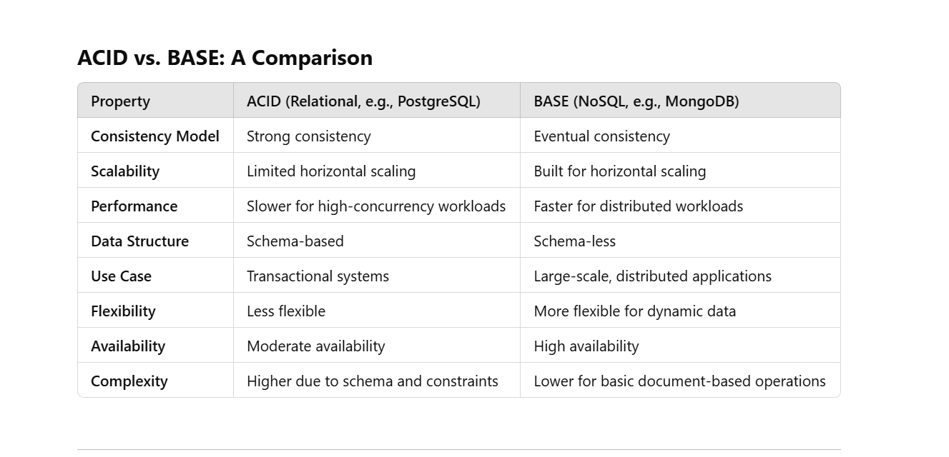
When to Use MongoDB and PostgreSQL

Slide 10
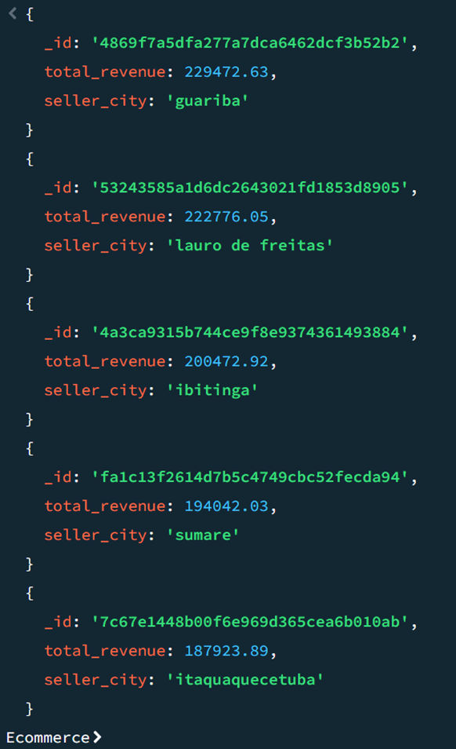
Why Denormalization
db.order_items.aggregate([
{
$lookup: {
from: "sellers",
localField: "seller_id",
foreignField: "seller_id",
as: "seller_details"
}
},
{ $unwind: "$seller_details" },
{
$group: {
_id: "$seller_id",
total_revenue: { $sum: "$price" },
seller_city: { $first: "$seller_details.seller_city" }
}
},
{ $sort: { total_revenue: -1 } },
{ $limit: 5 }
]).explain('executionStats');

Slide 11
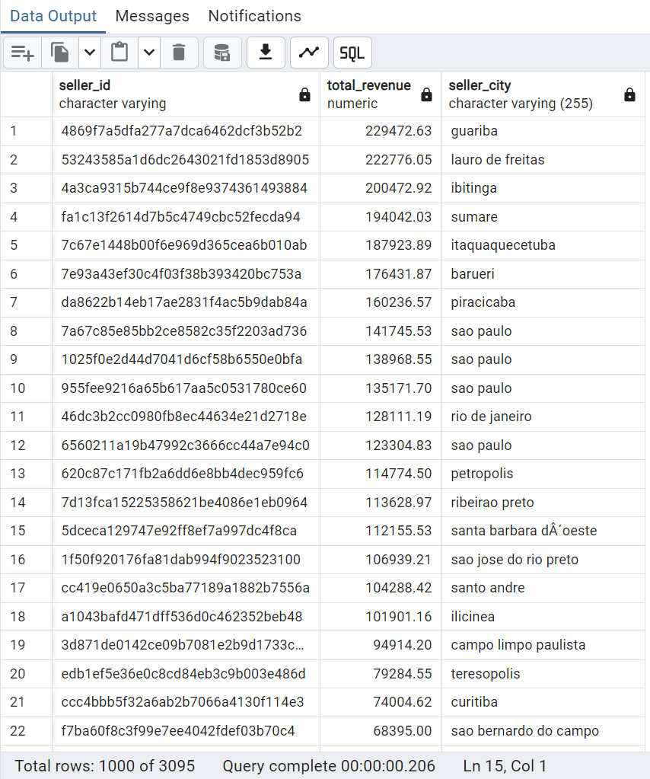
Why Denormalization
SELECT
oi.seller_id,
SUM(oi.price) AS total_revenue,
s.seller_city
FROM
order_items oi
JOIN
sellers s
ON
oi.seller_id = s.seller_id
GROUP BY
oi.seller_id, s.seller_city
ORDER BY
total_revenue DESC
LIMIT 5;

Slide 12
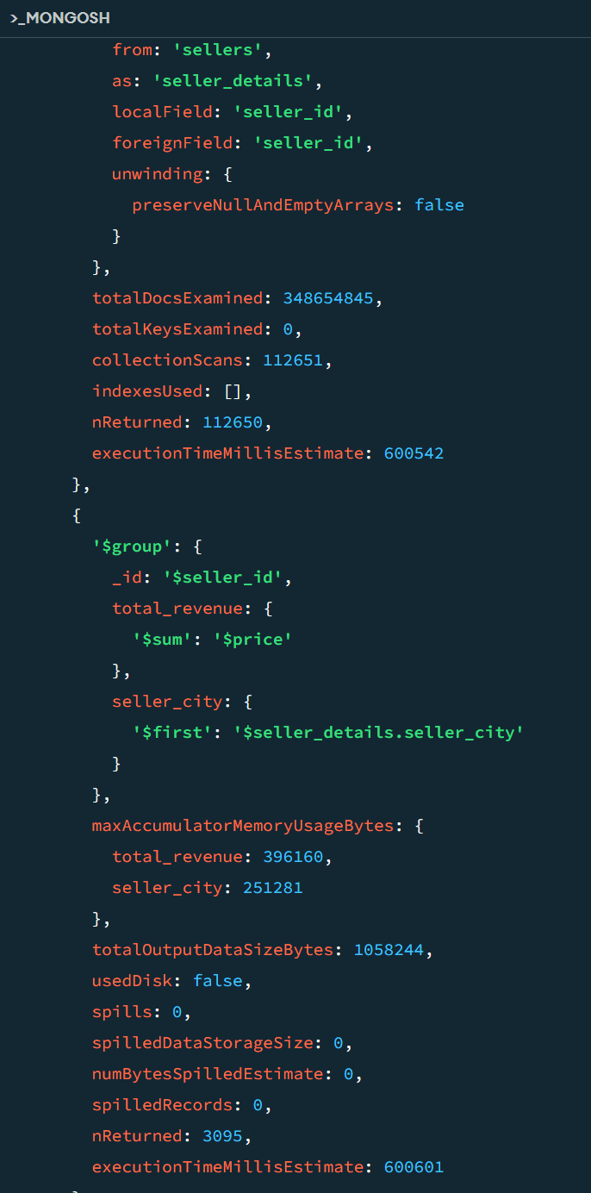
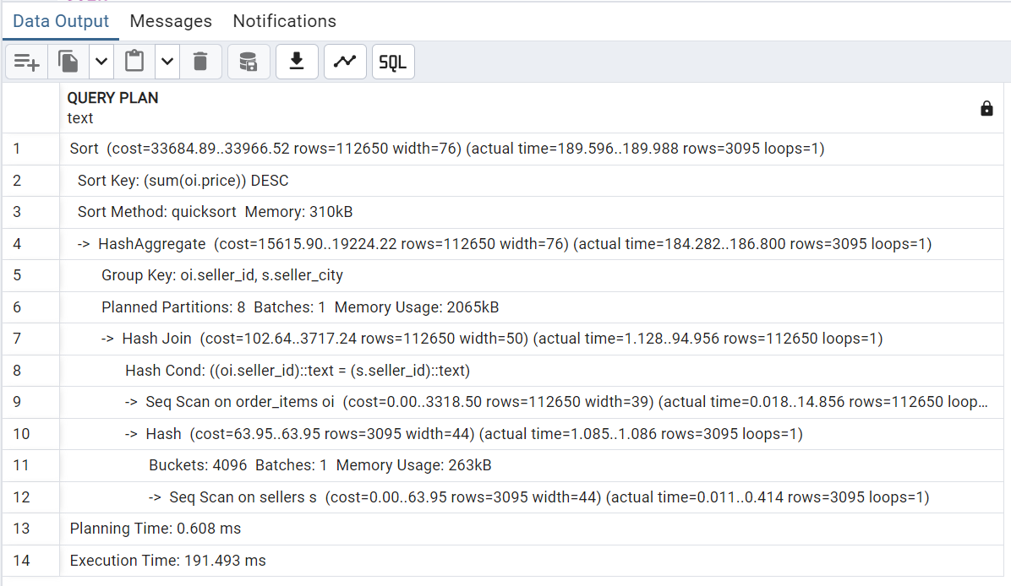
Why Denormalization

Slide 13
Why Denormalization
DBMS
Lookup Performance in MongoDB
No Native JOIN Support: MongoDB doesn't natively support JOINs the way relational databases like PostgreSQL do. The $lookup operator emulates JOINs by matching documents from one collection with another, which can be computationally expensive.
Inefficient for Large Datasets: The $lookup operator requires scanning documents across both collections to find matches. With millions of rows, this becomes time-intensive, especially if indexes are not properly defined.
Data Model Design: If your data in MongoDB is spread across multiple collections (normalized), performing lookups becomes slow. MongoDB is optimized for a denormalized (embedded) data model.
No Query Optimizer: MongoDB lacks a robust query planner and optimizer compared to PostgreSQL. This means query execution may not be as efficient for complex lookups.

Slide 14
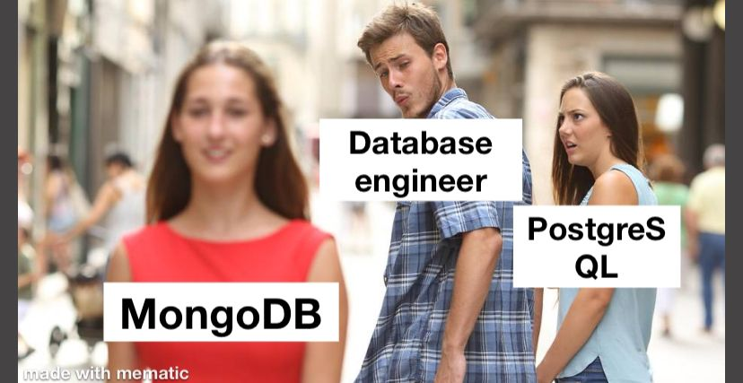

MEME OF THE DAY

Slide 15
Evaluation Factors
01.
02.
Performance
Scalability
03.
04.
Flexibility
Complexity
05.
Functionality

Slide 16

Performance
PostgreSQL:
Optimized for complex queries with JOINs across multiple tables.
Performs well for transactional workloads (OLTP) due to ACID compliance.
Indexing in PostgreSQL significantly boosts query speed for structured data.
MongoDB:
Performs better for read-heavy operations with unstructured data like JSON (e.g., customer reviews).
Faster for single-document operations or key-value lookups.
Lacks native JOIN functionality, so queries involving relationships (e.g., orders and customers) may require additional logic or manual joins.

Slide 17
Winner
For complex relational queries (e.g., combining orders, customers, products): PostgreSQL. (W)
For unstructured or schema-less data (e.g., customer reviews): MongoDB.

Slide 18
Scalability
PostgreSQL:
Vertical scaling: Adding more resources (CPU, RAM) improves performance.
MongoDB:
Built for horizontal scaling: Sharding allows MongoDB to scale out across distributed systems.
Limited horizontal scaling: Requires tools like Citus for distributed workloads.
Not ideal for massive datasets spanning multiple nodes.
Ideal for large-scale applications with millions of concurrent reads/writes.

Slide 19
Winner
For small to medium datasets with limited scaling needs: PostgreSQL. (W)
For large, distributed, and highly scalable systems: MongoDB.

Slide 20
Flexibility
PostgreSQL:
Requires a predefined schema, which enforces data integrity.
MongoDB:
Schema-less design allows flexibility in handling dynamic and unstructured data.
Less flexible if data structures frequently change.
Ideal for scenarios like storing user reviews with varying fields or nested data

Slide 21
Winner
MongoDB for schema flexibility
and handling diverse data
formats.

Slide 22
Complexity
PostgreSQL:
Higher complexity for schema design and query optimization.
MongoDB:
Easier to set up and manage for document-based data.
Managing relational dependencies (foreign keys, constraints) requires more effort.
Query syntax is simpler for basic operations but can become complex for aggregation.

Slide 23
Winner
MongoDB for simplicity, especially for non-relational use cases.

Slide 24
Functionality
PostgreSQL:
Rich query capabilities with support for advanced functions, triggers, and stored procedures.
MongoDB:
Advanced capabilities for working with JSON data and unstructured information.
Strong transactional consistency and integrity.
Eventual consistency can be a limitation for highly critical transactions

Slide 25
Winner
For complex transactional queries and strong consistency: PostgreSQL.(W)
For handling unstructured data and JSON-like formats: MongoDB.

Slide 26
QUERIES

Slide 27
Analyze the total number of products sold by sellers and calculate the percentage of their products returned by customers.
WITH SellerSales AS (
SELECT
s.seller_id,
COUNT(oi.order_id) AS total_products_sold,
COUNT(r.review_id) FILTER (WHERE r.review_score <= 2) AS returned_products
FROM
sellers s
INNER JOIN
order_items oi ON s.seller_id = oi.seller_id
LEFT JOIN
reviews r ON oi.order_id = r.order_id
GROUP BY
s.seller_id
)
SELECT
seller_id,
total_products_sold,
returned_products,
ROUND((returned_products * 100.0 / NULLIF(total_products_sold, 0)), 2) AS return_percentage
FROM
SellerSales
ORDER BY
return_percentage DESC;

Slide 28
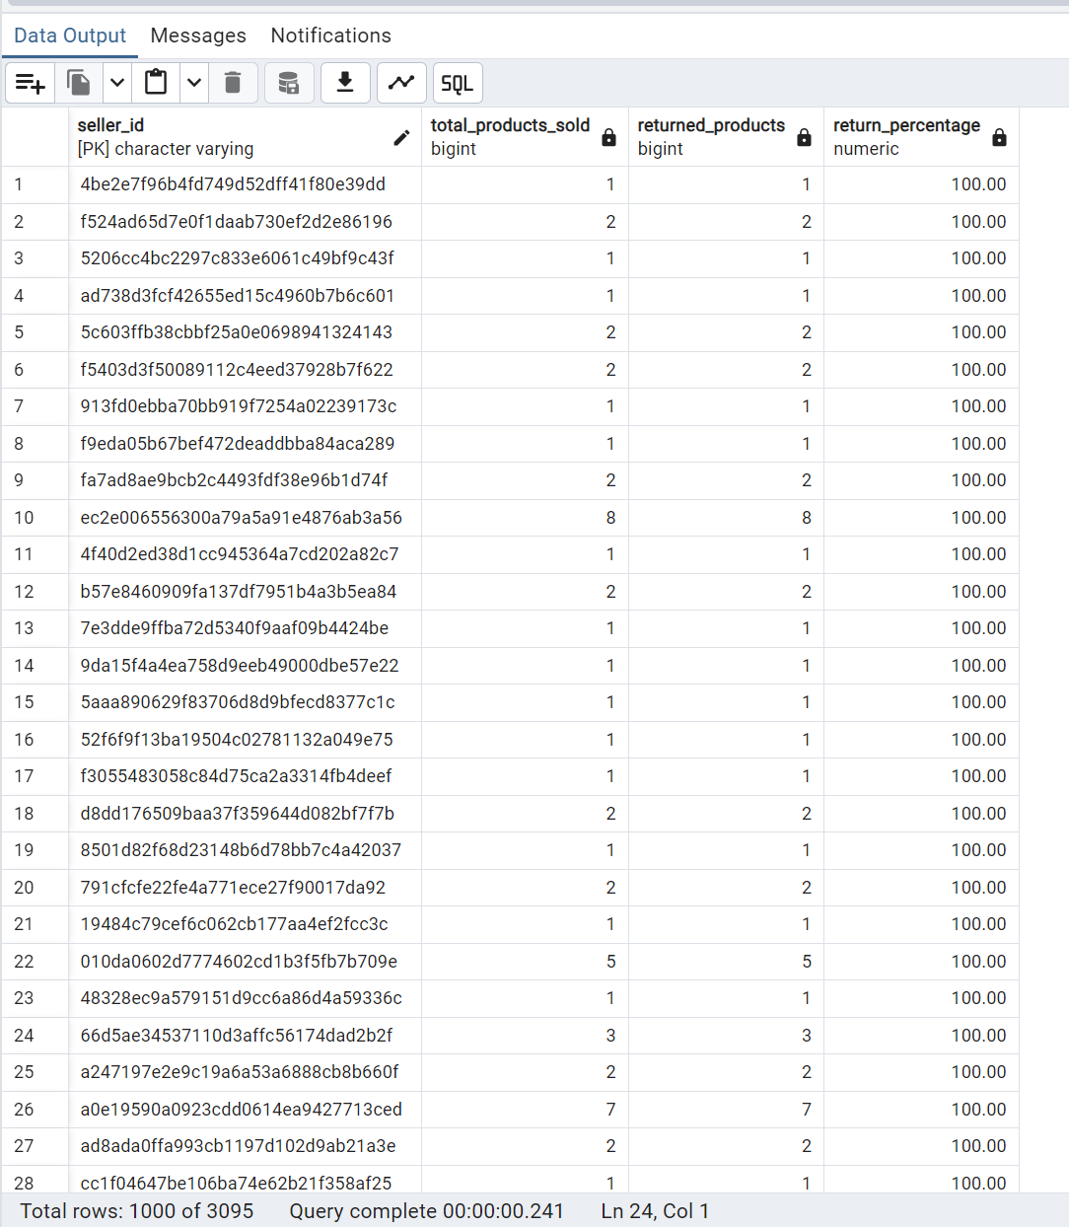
Managing Coordinators

Slide 29
Adjust pricing for products based on sales performance by region.
SELECT p.product_id, g.geolocation_state, AVG(oi.price) as avg_price, CASE
WHEN SUM(oi.price) > 10000 THEN 'Increase Price'
WHEN SUM(oi.price) < 5000 THEN 'Decrease Price'
ELSE 'Maintain Price'
END as price_adjustment
FROM products p
JOIN order_items oi ON p.product_id = oi.product_id
JOIN orders o ON oi.order_id = o.order_id
JOIN customers c ON o.customer_id = c.customer_id
JOIN geolocation g ON c.customer_zip_code_prefix = g.geolocation_zip_code_prefix
GROUP BY p.product_id, g.geolocation_state;

Slide 30
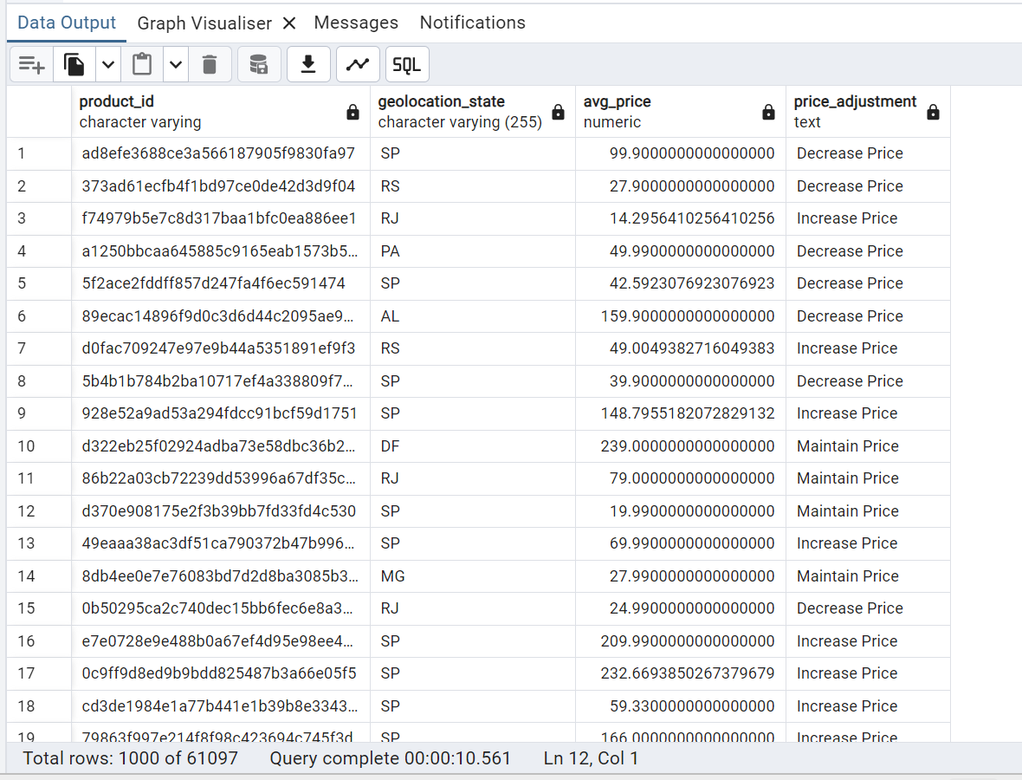

Slide 31
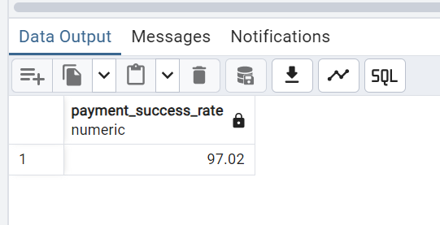
Payment Success Rate (Postgre)
SELECT
ROUND((COUNT(*) FILTER (WHERE order_status = 'delivered')::DECIMAL / COUNT(*) * 100), 2) AS payment_success_rate
FROM orders;

Slide 32
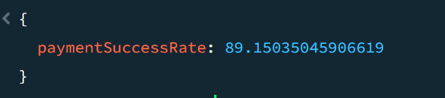
Payment Success Rate (MongoDB)
db.orders_customers.aggregate([
{
$group: {
_id: null,
totalOrders: { $sum: 1 }, // Total number of orders
deliveredOrders: { $sum: { $cond: [{ $eq: ["$order_status", "delivered"] }, 1, 0] } } // Count of delivered orders
}
},
{
$project: {
_id: 0,
paymentSuccessRate: {
$multiply: [
{ $divide: ["$deliveredOrders", "$totalOrders"] },
100
]
}
}
}
]);

Slide 33
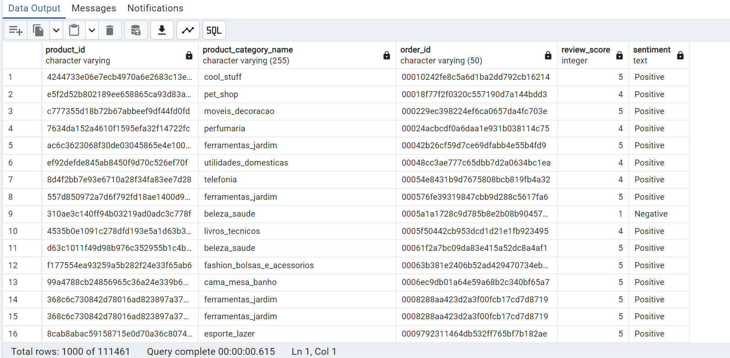
Review Sentiment Analysis (Postgre)
SELECT
p.product_id,
p.product_category_name,
r.order_id,
r.review_score,
CASE
WHEN r.review_score = 3 THEN 'Neutral'
WHEN r.review_score > 3 THEN 'Positive'
ELSE 'Negative'
END AS sentiment
FROM public.reviews r
JOIN public.orders o ON r.order_id = o.order_id
JOIN public.order_items oi ON o.order_id = oi.order_id
JOIN public.products p ON oi.product_id = p.product_id;

Slide 34
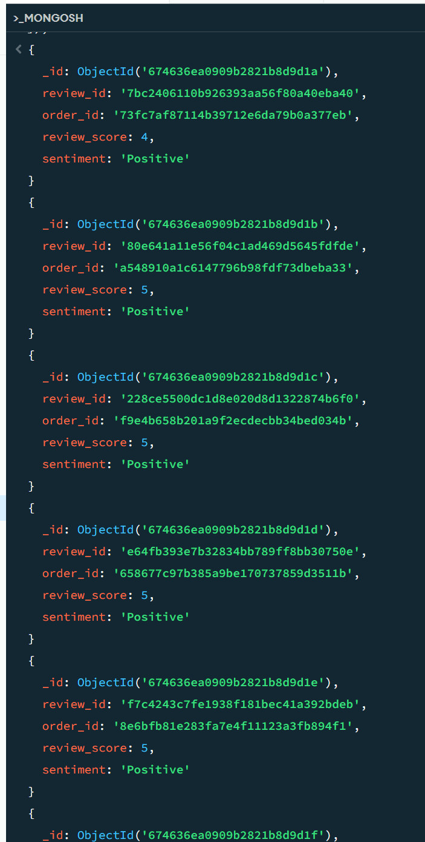
Review Sentiment Analysis (MongoDB)
db.reviews_orders.aggregate([
{
$project: {
review_id: 1,
order_id: 1,
review_score: 1,
sentiment: {
$cond: [
{ $eq: ["$review_score", 3] },
"Neutral",
{
$cond: [
{ $gt: ["$review_score", 3] },
"Positive",
"Negative"
]
}
]
}
}
}
]);

Slide 35
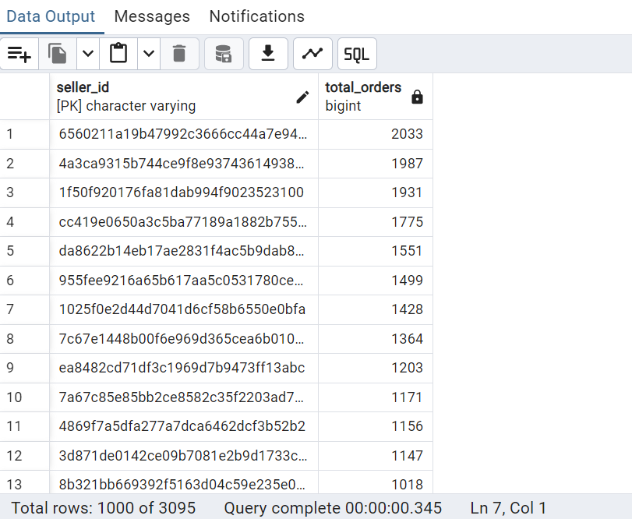
Order Processing (Postgre)
1. Count of total orders processed per seller:
SELECT s.seller_id, COUNT(o.order_id) AS total_orders FROM sellers s JOIN order_items oi ON s.seller_id = oi.seller_id JOIN orders o ON oi.order_id = o.order_id GROUP BY s.seller_id ORDER BY total_orders DESC;

Slide 36
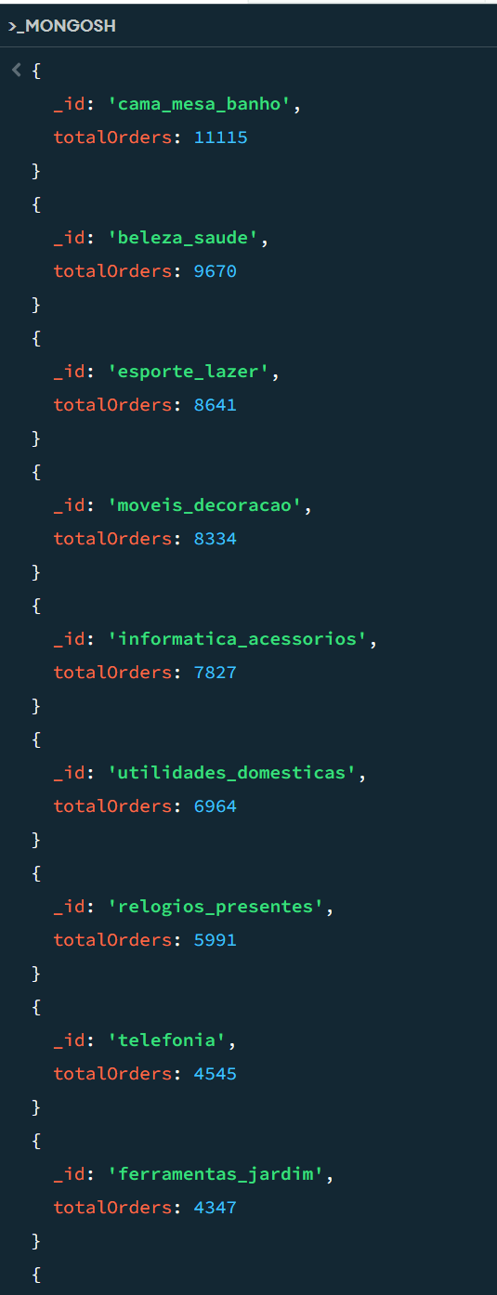
Order Processing (MongoDB)
Count of Orders Per Product Category: db.order_items_products.aggregate([ { $group: { _id: "$product_category_name", totalOrders: { $sum: 1 } } }, { $sort: { totalOrders: -1 } } ]);

Slide 37
Thank You!

